Slide 1
Applications of Linear Equations / Intro to Linear Modeling
MATH A104
Megan Gobeille

Slide 2
Intro to word problems
Translating is key
Read word problem over a few times
Understand it well enough to paraphrase it
Identify what the problem is asking for
Identify what information you are given
Take note of any units that may help us

Slide 3
Intro to word problems
Translating is key
Read word problem over a few times
Understand it well enough to paraphrase it
Identify what the problem is asking for
Identify what information you are given
Take note of any units that may help us
Do the actual translation
Do NOT do computations at this time!

Slide 4
Intro to word problems
Translating is key
Read word problem over a few times
Understand it well enough to paraphrase it
Identify what the problem is asking for
Identify what information you are given
Take note of any units that may help us
Do the actual translation
Do NOT do computations at this time!
Solve.
Check and state your answer
Does it make sense?

Slide 5
Mathematical Modeling
What is it?
Suggestions of how to think about it.

Slide 6
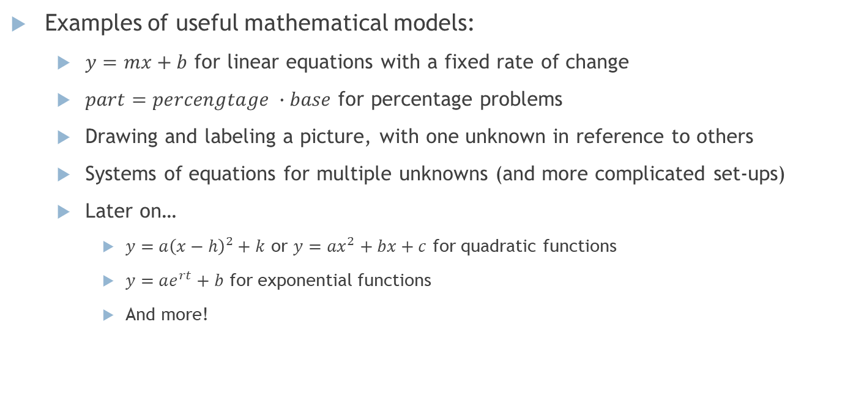
Mathematical Modeling
Examples of useful mathematical models:
$y=mx+b$ for linear equations with a fixed rate of change
$part=percengtage ∙base$ for percentage problems
Drawing and labeling a picture, with one unknown in reference to others
Systems of equations for multiple unknowns (and more complicated set-ups)
Later on…
$y=a{\left(x−h\right)}^{2}+k$ or $y=ax^{2}+bx+c$ for quadratic functions
$y=ae^{rt}+b$ for exponential functions
And more!

Slide 7
Mathematical Modeling
In ALL of these we must…
Recognize the math involved. (Pick a model.)
Identify what information plugs in where. (Does a number have to do with the rate or the initial value?)
See how the information given applies. (For example, are you given slope directly, or will you need to calculate it first?)
Let’s go through those steps with the following problem:

Slide 8

Math modeling
You moved across town and rented a 20 foot moving truck for the day. You want to make sure the bill you got checks out. If you paid $81.03, for how many miles were you charged? (Assume no fees.)
What type of equation is this? / What set up should we use?
Define your variable.
What is the pertinent information?

Slide 9
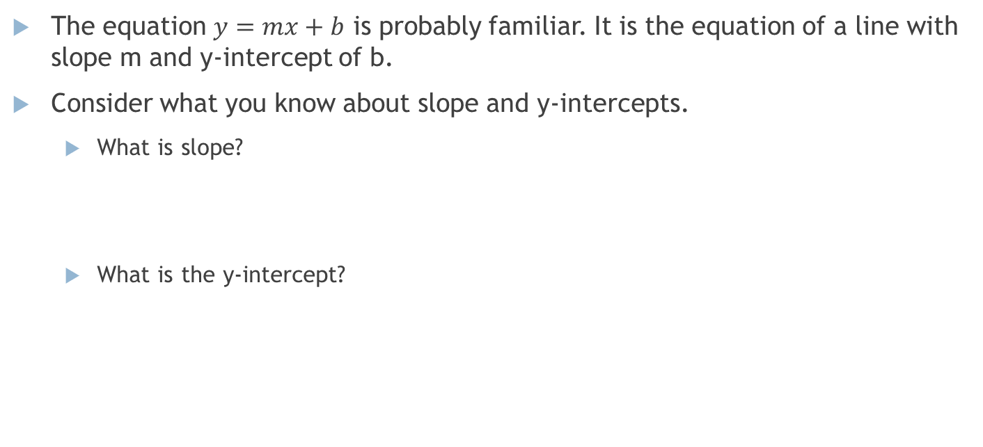

Math modeling: $y=mx+b$
The equation $y=mx+b$ is probably familiar. It is the equation of a line with slope m and y-intercept of b.
Consider what you know about slope and y-intercepts.
What is slope?
What is the y-intercept?

Slide 10
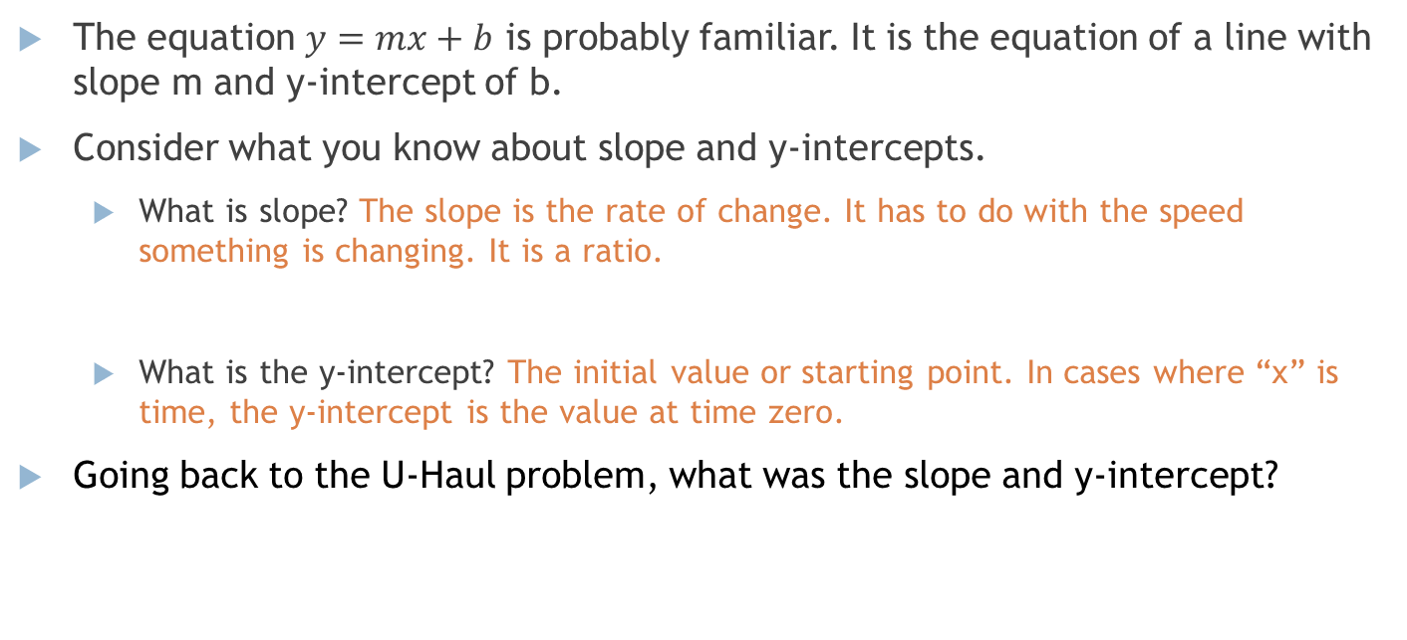
Math modeling: $y=mx+b$
The equation $y=mx+b$ is probably familiar. It is the equation of a line with slope m and y-intercept of b.
Consider what you know about slope and y-intercepts.
What is slope? The slope is the rate of change. It has to do with the speed something is changing. It is a ratio.
What is the y-intercept? The initial value or starting point. In cases where “x” is time, the y-intercept is the value at time zero.
Going back to the U-Haul problem, what was the slope and y-intercept?

Slide 11
Math Modeling, another example
An interior wall measures 30 ft 4 in long. It is to be divided by 10 evenly spaced posts; each post is 4 in by 4 in. Two of the posts will be in the corners. What is the distance between posts?
Hint: notice that there are 9 spaces between posts.

Slide 12
Math Modeling, another example
An interior wall measures 30 ft 4 in long. It is to be divided by 10 evenly spaced posts; each post is 4 in by 4 in. Two of the posts will be in the corners. What is the distance between posts?
Hint: notice that there are 9 spaces between posts.
30 ft 4 in

Slide 13
Math Modeling, another example
An interior wall measures 30 ft 4 in long. It is to be divided by 10 evenly spaced posts; each post is 4 in by 4 in. Two of the posts will be in the corners. What is the distance between posts?
Hint: notice that there are 9 spaces between posts.
Question: how is “What is the distance between posts?” different from “How far apart should you drill holes to fit the posts?
30 ft 4 in

